Slide 1


American International University- Bangladesh
Natural Language Processing
Group-3
Mahin
Montasir Afif
HASIN ALMAS SIFAT
MD. RIFAT KHAN
A.H.M. TANVIR
22-46573-1
22-48679-3
22-46060-1
22-47034-1

Slide 2



RoBERTa: A Robustly Optimized BERT Pretraining Approach
Yinhan Liu∗, Myle Ott∗, NamanGoyal∗, Jingfei Du∗, Mandar Joshi,
Danqi Chen, OmerLevy, MikeLewis, Luke Zettlemoyer, Veselin Stoyanov

Slide 3


Introduction
to
RoBERTa
Means training a model on a large amount of general data before using it for specific tasks.
Pretraining gives the model a "basic understanding of language", like a student learning grammar before writing essays.
Robustly Optimized BERT Pretraining Approach
Reads a sentence both from left to right and right to left at the same time.
Bidirectional Encoder Representations from Transformers
Designed to understand the meaning of words in context using a mechanism called self-attention.
Ex: In the sentence: “The cat sat on the mat because it was tired.”

Slide 4
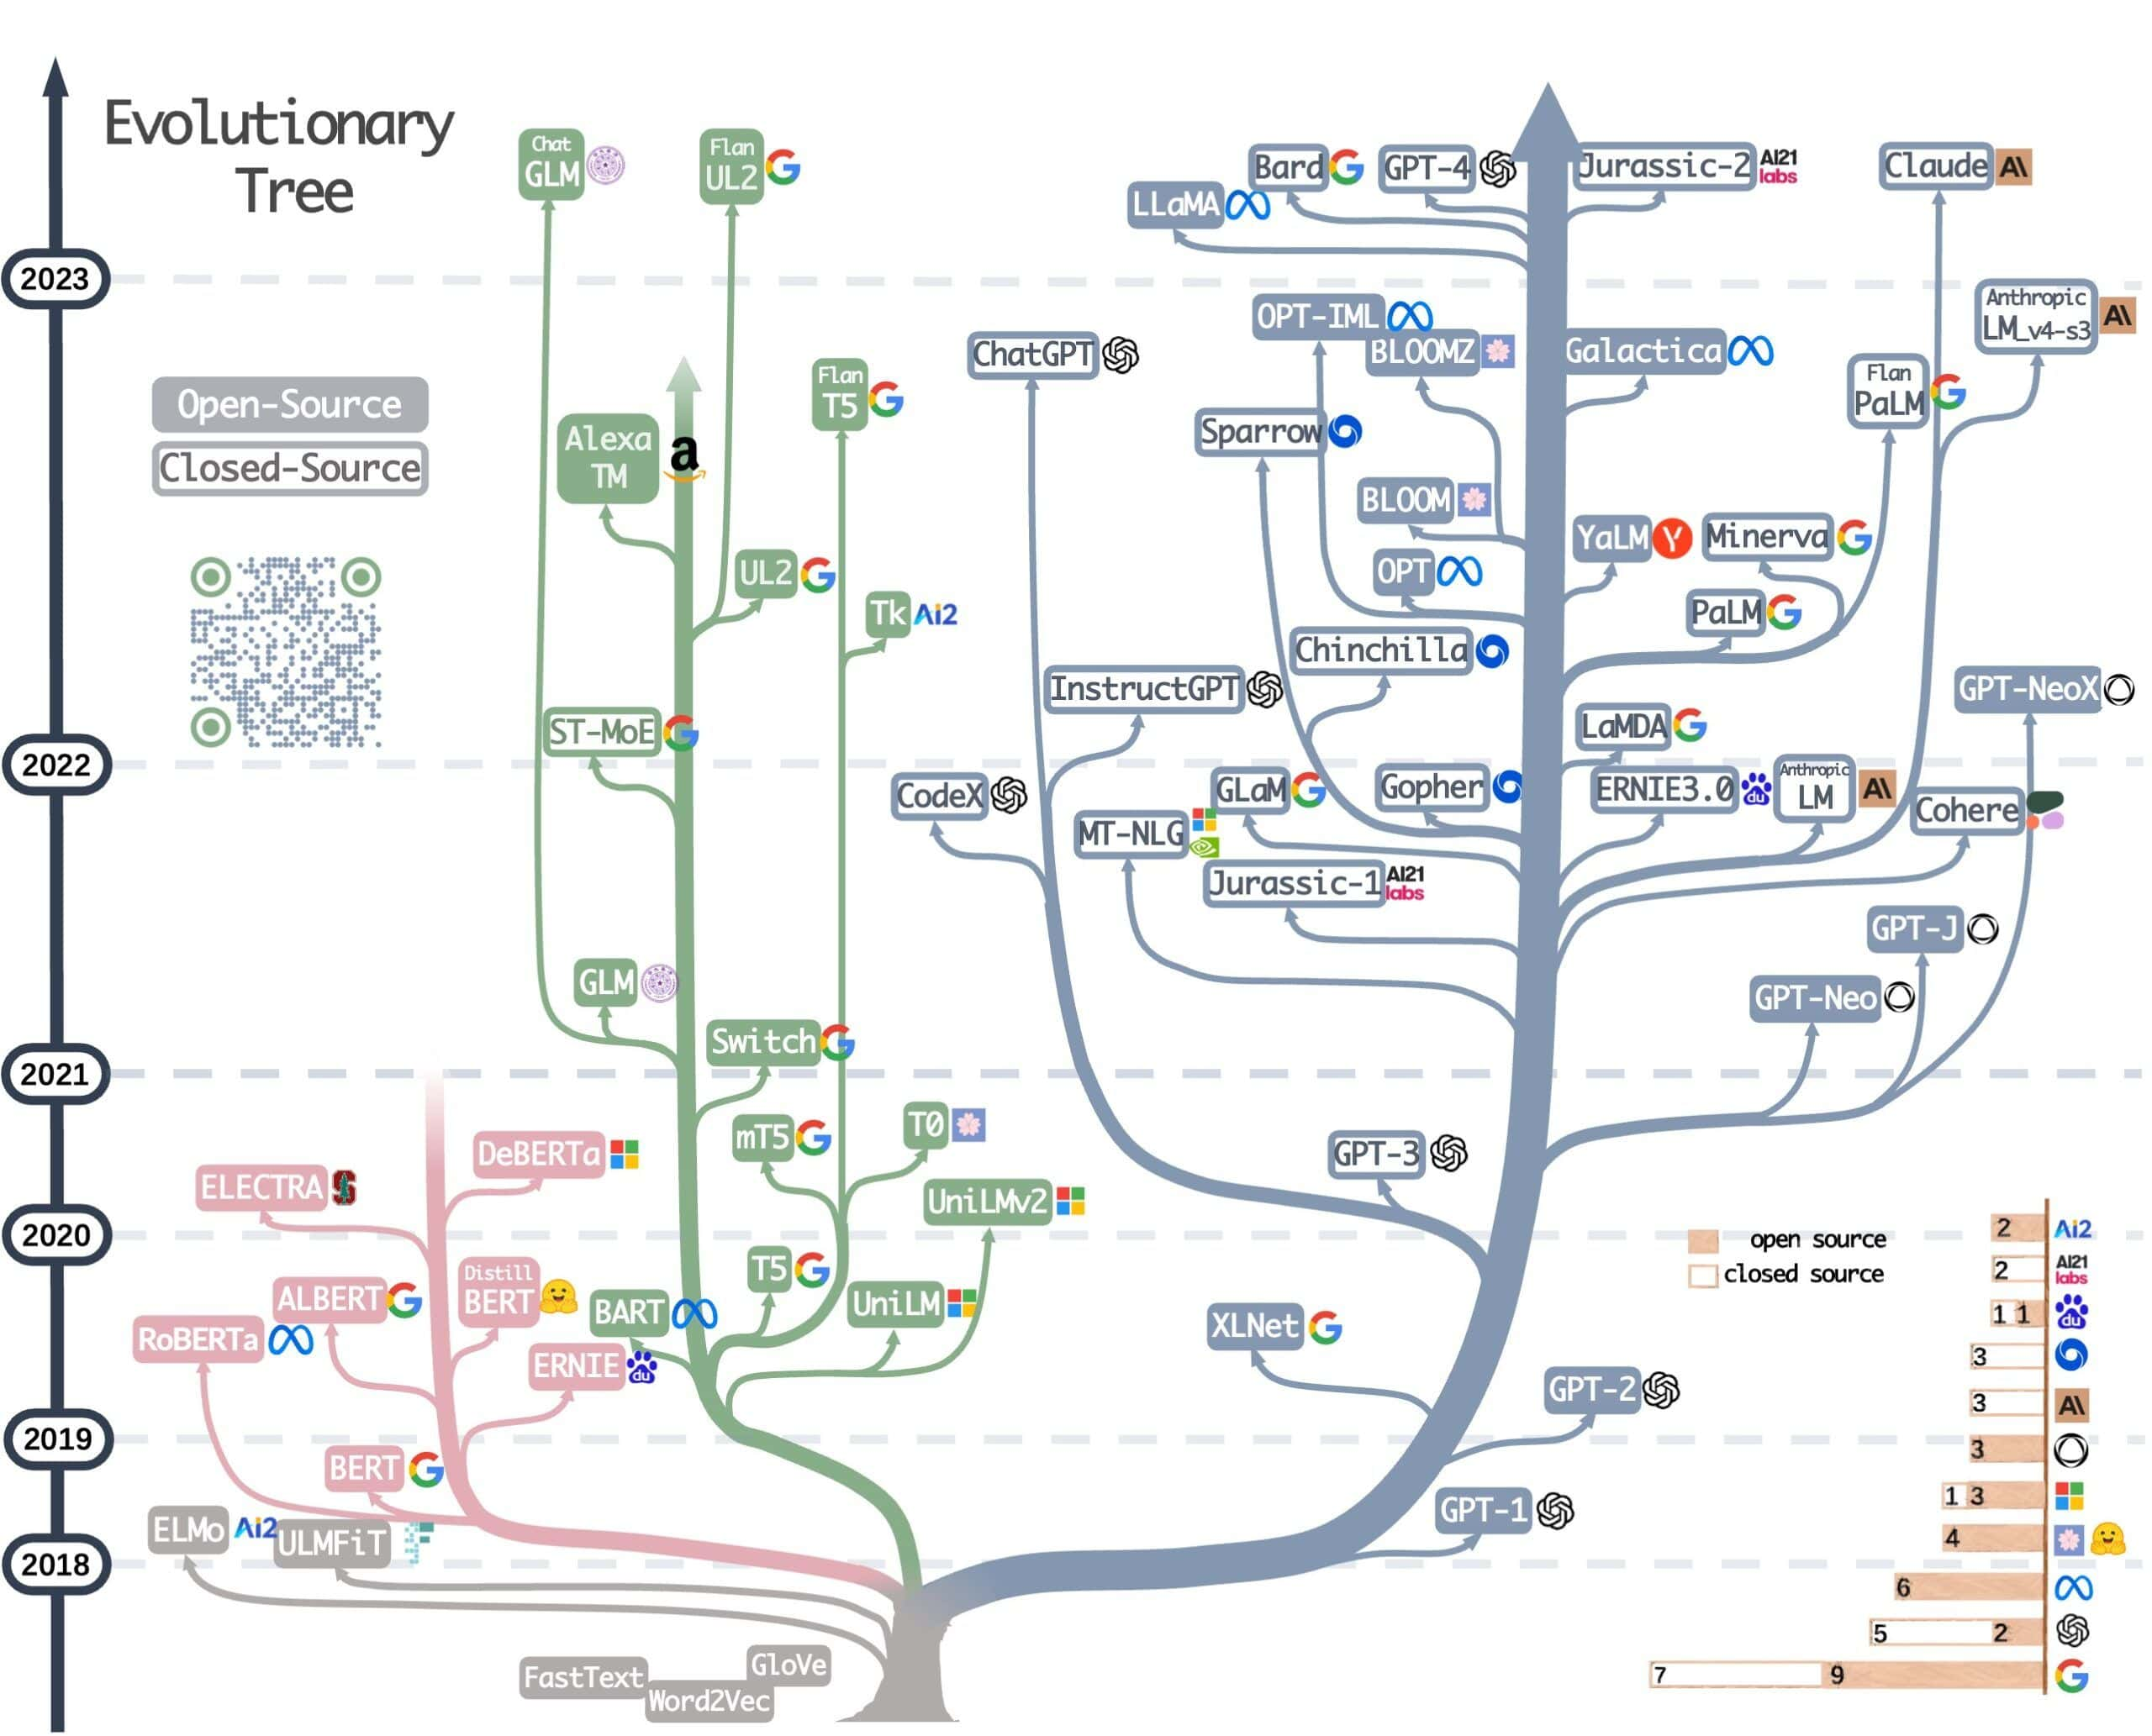
Types of Transformers
Encoder-only transformers – suitable for tasks that require understanding the input, such as sentence classification and named entity recognition. Some of the popular models are BERT, RoBERTa, and DistilBERT.
Decoder-only transformers – effective for generative tasks such as text generation. Some of the popular models are GPT, LLaMA, and Falcon.
Encoder-decoder transformers – suitable for generative tasks that require input, such as translation or summarization. Popular encoder-decoder models are BART, T5, and UL2.
Self-Attention
Feedforward Network
Figure: Transformer’s Evolutionary Tree
Layer of an Encoder-only transformer

Slide 5
BERT Architecture
Encoder Layers
Input Representation
Self-Attention
Feedforward Network
[CLS] token at the start
[SEP] token to separate sentences
Output
Word Embeddings
Segment Embeddings
For classification: Output of the [CLS] token goes to a classifier.
Position Embeddings
For tasks like Q&A: Outputs for all tokens are used to find answers.

Slide 6

Why RoBERTa Was Developed ?
Bert’s limited dataset
Enhancing BERT by-
Studies revealed that BERT was undertrained, constrained by a 16GB dataset (BOOKCORPUS and Wikipedia) and limited training steps.
Training the model longer, with bigger batches, over more data.
Removing the next sentence prediction objective
Training on longer sequences.
Dynamically changing the masking pattern applied to the training data.
Bert’s inclusion of the NSP task
Researchers found that NSP task was less effective than anticipated.
More data + more time = better understanding of language.
The model gets a more diverse learning experience, leading to better generalization.
?
Model had to guess if one sentence follows another.
Model understand long-range dependencies between words.

Slide 7
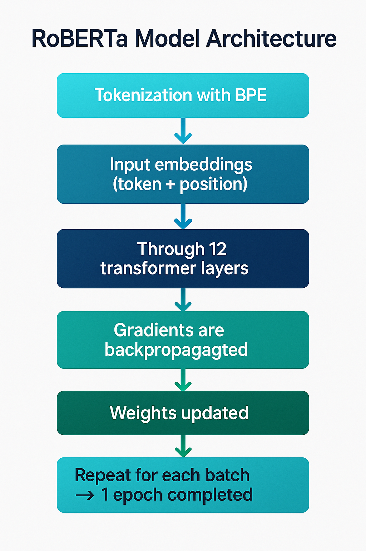

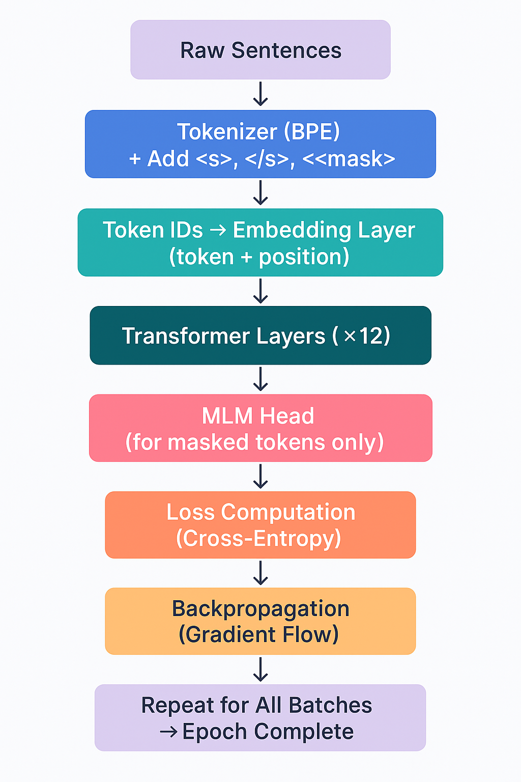

RoBERTa Basic Model Overview
Input text is tokenized using Byte Pair Encoding (BPE), with special tokens <s>, </s>, and <mask>.
Tokens are converted to embeddings (token + positional).
Passed through 12 Transformer encoder layers.
Final outputs go to heads like classification or MLM (masked language modeling).

Slide 8
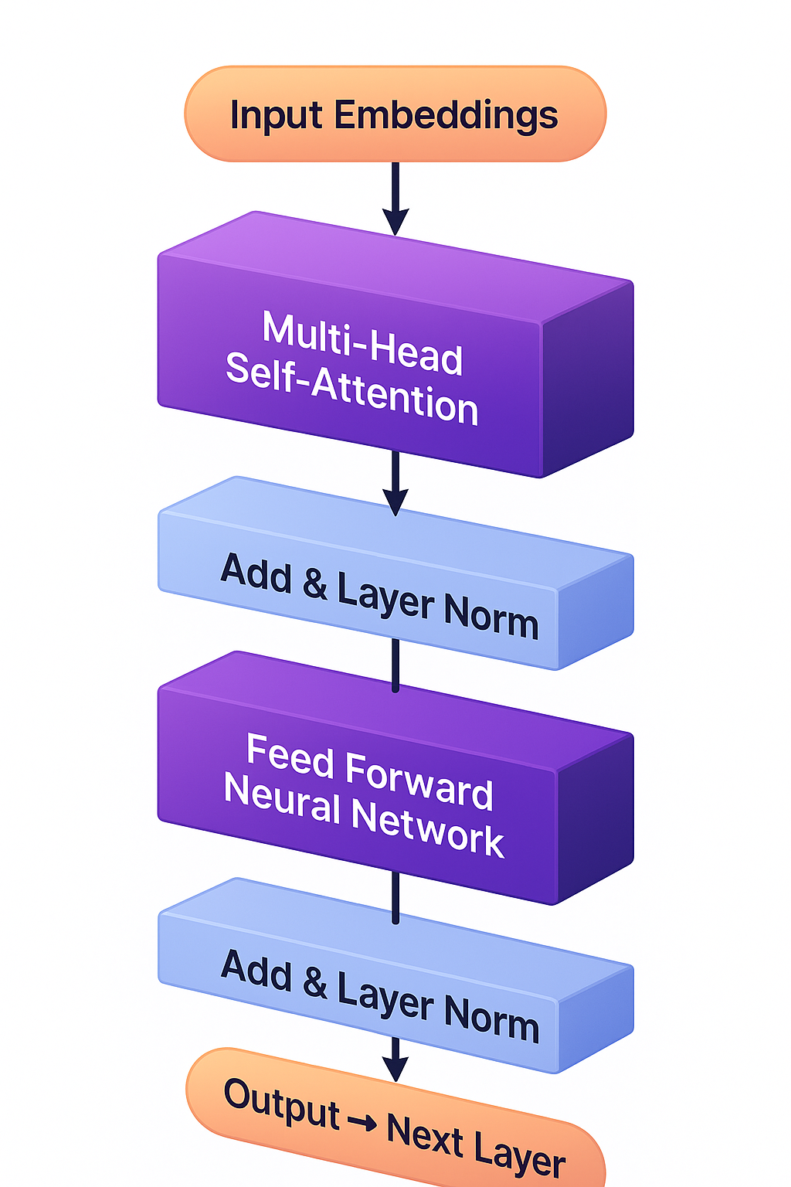
Layer Architecture
Input Embeddings
Vectors representing tokens + their positions.
Multi-Head Self-Attention
Enables each token to focus on other tokens in the sequence.
Multiple "heads" capture different types of relationships.
Add & LayerNorm
Add: Residual connection — original input is added to the output of the previous block.
LayerNorm: Normalizes the values to stabilize and accelerate training.
Feed-Forward Neural Network (FFN)
A fully connected dense layer applied to each token vector independently.
Adds non-linearity and transformation capacity.
Output → Next Layer
The processed representation is passed to the next Transformer layer.

Slide 9

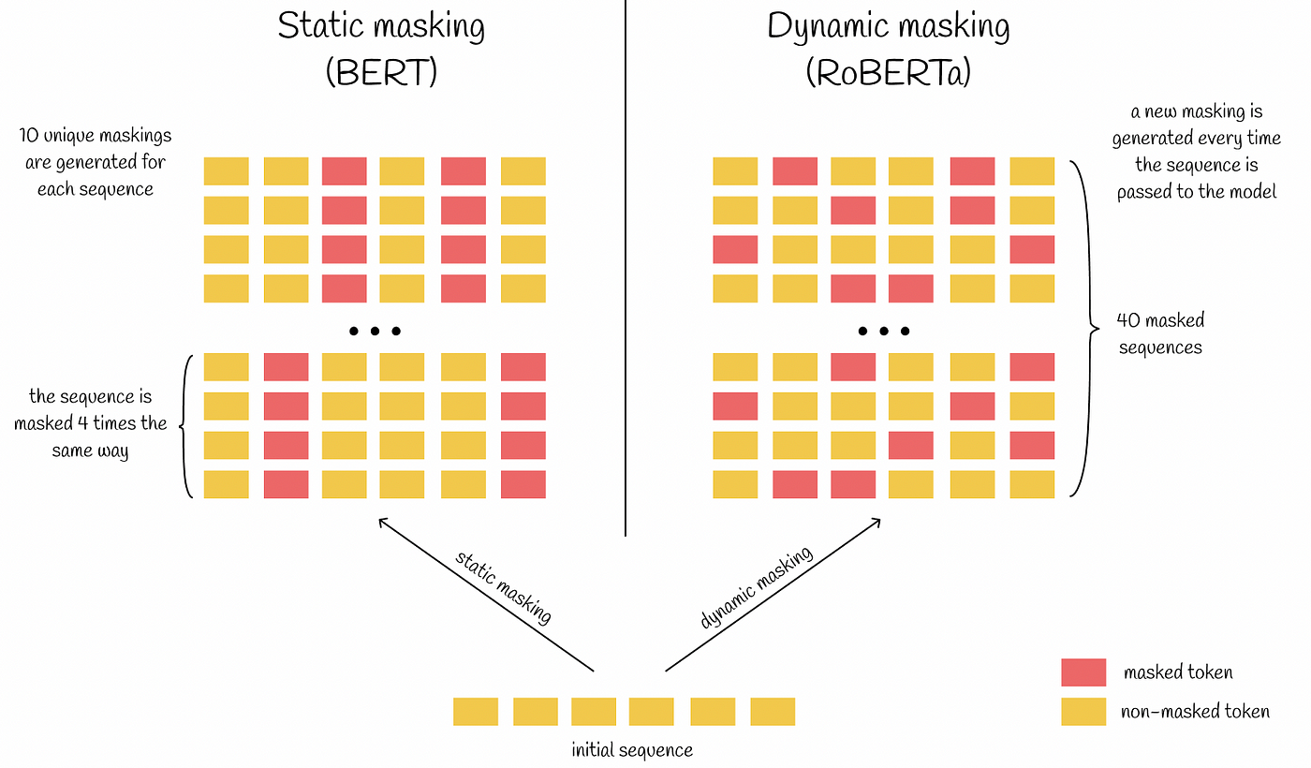
Masking Architectural Difference

Slide 10

Parameter Descriptions and Effects on Results
Parameter
Description
Effect on Performance
Training Duration
RoBERTa was trained for up to 500,000 steps.
Longer training enhances model generalization. SQuAD v1.1 F1 score rose from
93.6 to 94.6 with more steps.
Larger batches reduce perplexity and improve task performance
Batch Size
Evaluated with 256, 2K, and 8K sequences. RoBERTa used 8K sequences effectively.
Learning Rate
Adjusted according to batch size (1e -4 for 256, 1e -3 for 8K).
Higher learning rates with large batches help stabilize and speed up training
A larger corpus significantly boosts performance and model generalization across tasks
Slight improvements in performance over static masking.
Model performs better without NSP. FULL -SENTENCES format showed highest F1 in SQuAD 2.0
Helps capture longer context dependencies and improves accuracy
Minimizes unknown tokens and increases model’s ability to handle rare or diverse tokens
RoBERTa_LARGE significantly outperforms BASE
Data Size
160GB total, using BOOKCORPUS, Wikipedia, CC-NEWS, OpenWebText, and Stories.
Masking Strategy
Dynamic masking regenerates token masks per training instance.
NSP Objective
Next Sentence Prediction (NSP) objective removed.
Input Format
Trains on FULL-SENTENCES format (512 tokens).
Text Encoding
Byte -level BPE with 50K subword units.
Model Architecture
Two main configurations: BASE (12 layers, 768 hidden units), LARGE (24 layers, 1024 hidden units).

Slide 11
BERT vs RoBERTa: Key Differences
Aspect | BERT | RoBERTa
Training Duration | 1,000,000 steps, batch size 256 | Up to 500,000 steps, batch size up to 8,000
Training Data | 16GB (BOOKCORPUS + Wikipedia) | 160GB (CC-NEWS, OpenWebText, Stories)
NSP Objective | Included | Removed, uses FULL-SENTENCES
Masking Strategy | Static | Dynamic
Input Format | Concatenated segments | Full -length sequences
Text Encoding | Character -level BPE, 30K units | Byte -level BPE, 50K units
Performance | Outperformed by later models | State -of -the -art on GLUE, SQuAD, RACE

Slide 12

Performance on GLUE
RoBERTa’s Performance:
MNLI: 90.2% accuracy
QNLI: 94.7% accuracy
SST-2: 96.4% accuracy
BERT’s Performance:
MNLI: 86.6% accuracy
SST-2: 93.5% accuracy

Slide 13
Performance on SQuAD
RoBERTa’s Performance:
SQuAD 1.1: F1 = 94.6
SQuAD 2.0: F1 = 89.4
Comparison with BERT:
SQuAD 1.1: BERT = 90.9
SQuAD 2.0: BERT = 86.5

Slide 14

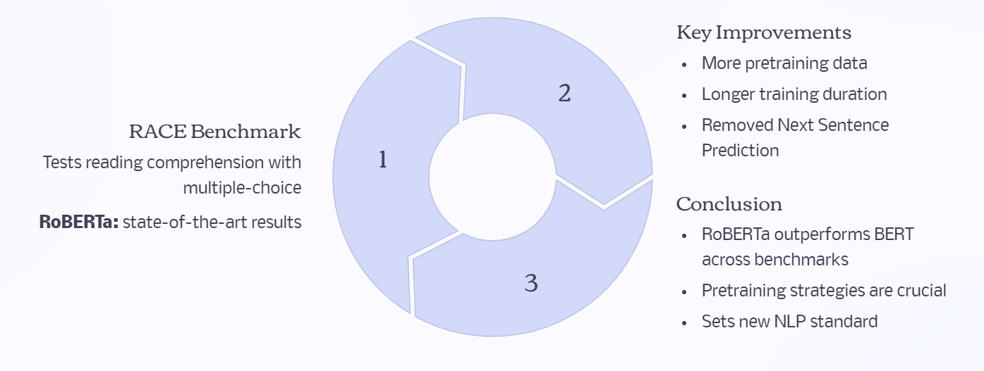

RoBERTa’s Performance on RACE

Slide 15

Thank You

